Slide 1
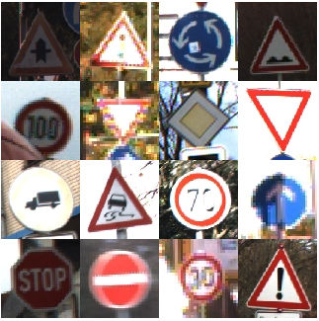
Road sign recognition
By
Prateesh Reddy Patlolla
GitHub link

Slide 2
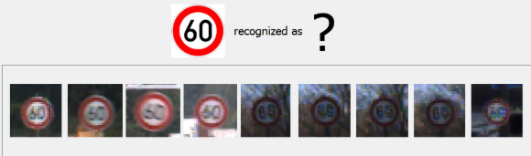
AIM
To recognize or classify road signs
We use GTSRB dataset
43 classes
More than 50,000 images in total
Large, lifelike database
Reliable ground-truth data due to semi-automatic annotation
Physical traffic sign instances are unique within the dataset

Slide 3
Technologies performed
Histogram equalization
Data Pipeline
Data Augmentation
Adam optimization
Dropout regularization
GitHub link : https://github.com/prateeshreddy/GTSRB_road_sign_recog

Slide 4
Data Pipeline
The tf.data API allows you to build an asynchronous, highly optimized data pipeline to prevent your GPU from data starvation.
It loads images from the disk applies optimized transformations, creates batches and sends it to the GPU.
Former data pipelines made the GPU wait for the CPU to load the data, leading to performance issues.

Slide 5
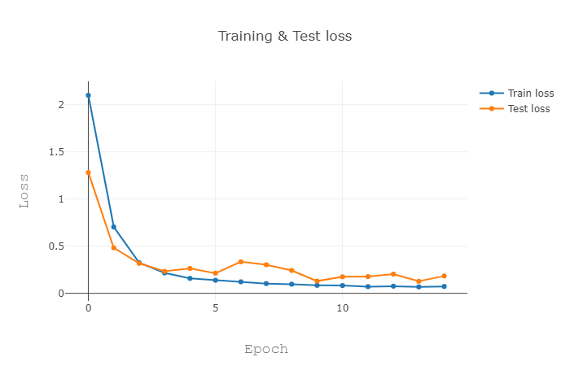
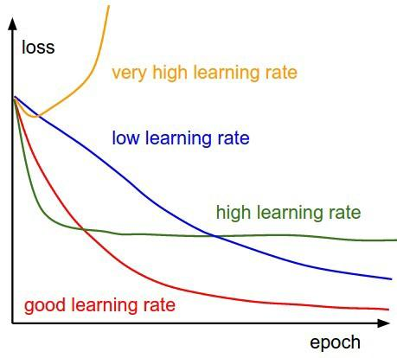
Result Analysis
Loss Curve

Slide 6
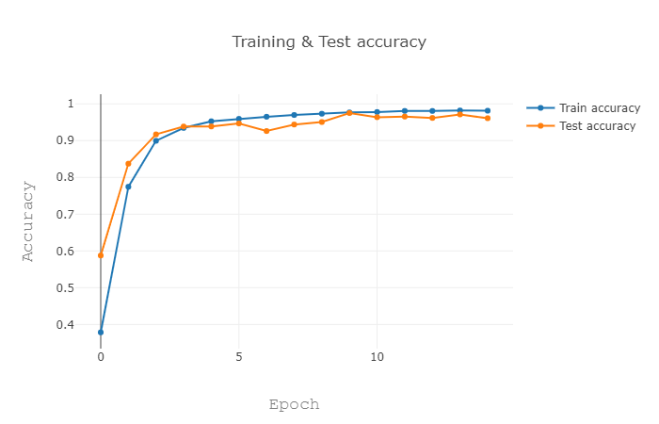
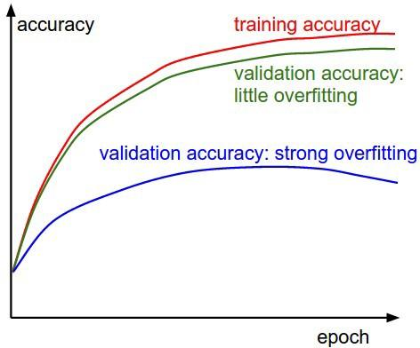
Result Analysis
Accuracy curve

Slide 7
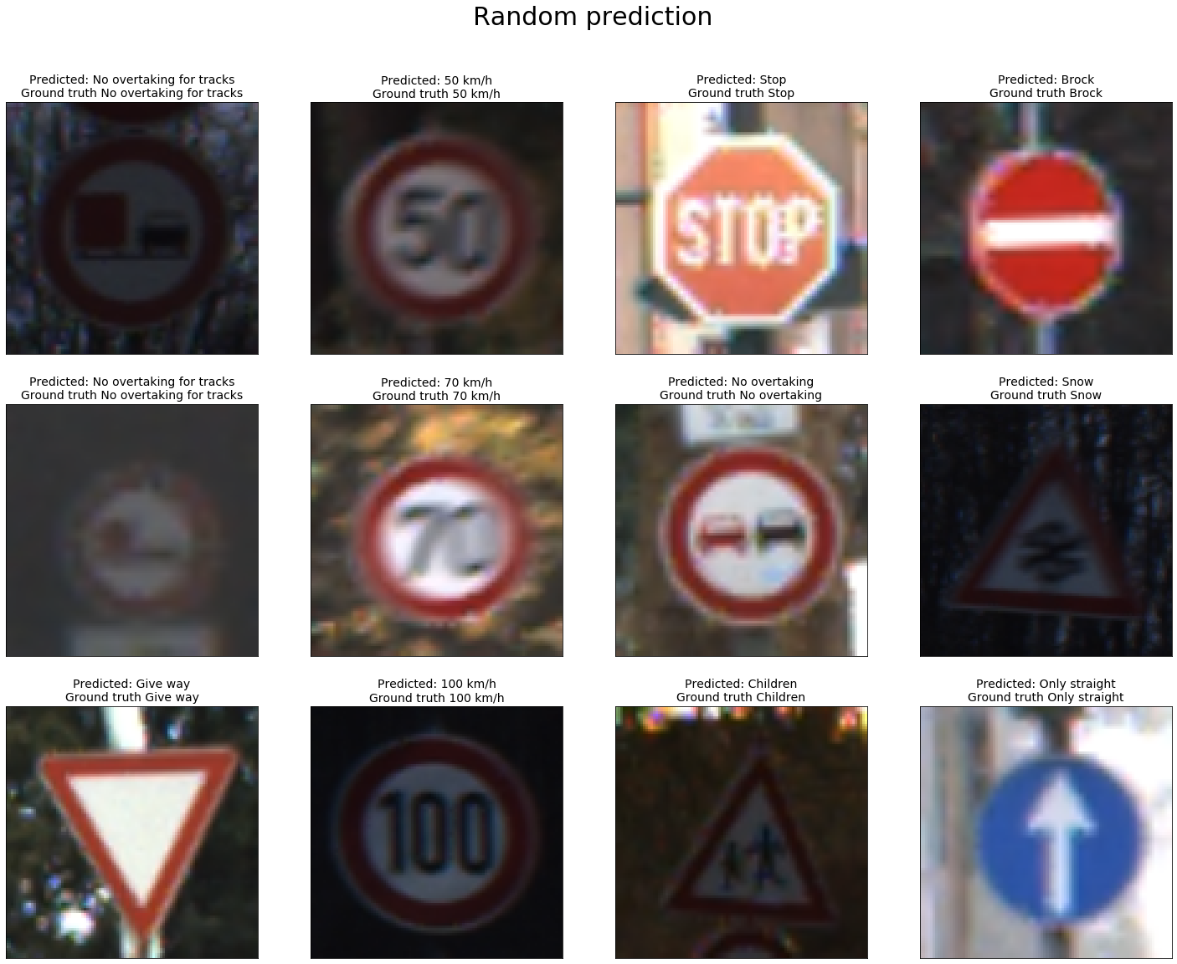

Slide 8
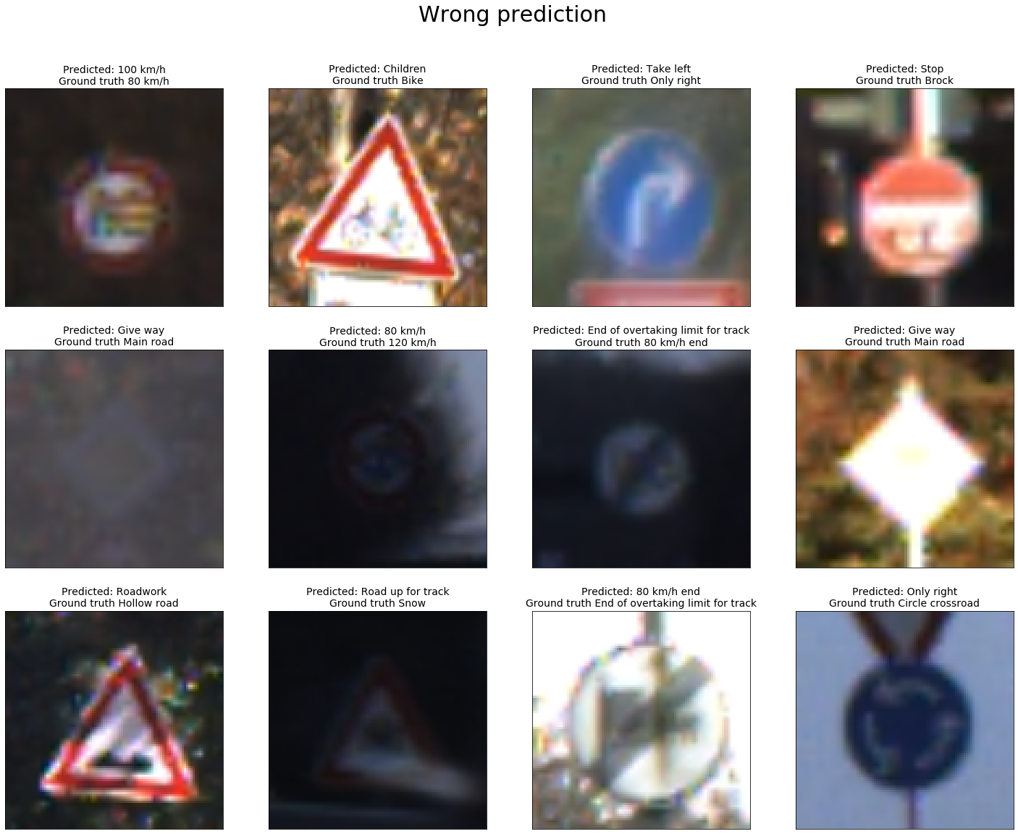

Slide 9
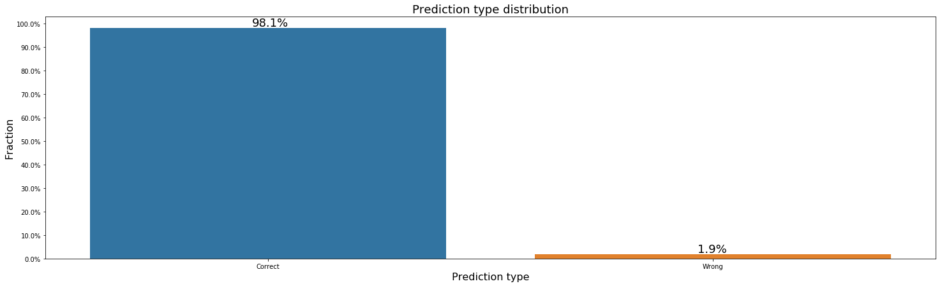
Output
After 20 epochs this model scored 98.1% accuracy on the test set.
As there were a total of 12,630 images that we used for testing (Correct- 12,383 | Wrong- 241)

Slide 10
Output
Apparently there are 85 examples that the model could not classify correctly.
In conclusion, according to different sources human performance on a similar task varies from 98% to 98.6%
Thus this model seems to outperform an average human. Which I believe is the ultimate goal of machine learning!

Slide 11
References
Traffic Sign Recognition with Multi-Scale CNN Paper By Yann LeCun and Pierre Sermanet
Building a data pipeline Using Tensorflow tf.data By Andrew Ng and Kian Katanforoosh
Recognising Traffic Signs Using Deep Learning By Eddie Forson an article from towardsdatascience.

